Slide 1
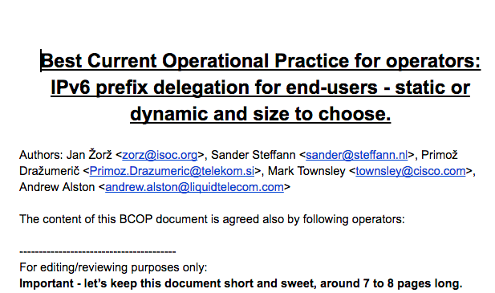

Slide 2
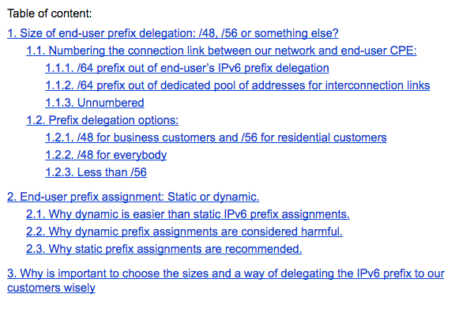

Slide 3
Process
Document resides and is edited/written on Google Documents platform
We need:
Operators with practical experience to co-author
Operators with practical experience to read it, comment and at the end put their name on it under “agreed by” section, of course if they agree with the content.
Help from RIPE IPv6 WG to check the technical validity of the content

Slide 4
Questions/comments/volunteers?
R/O URL: http://tinyurl.com/ipv6-pd-bcop
Do people think this could be an useful document?
Discussion!!!
Jan Žorž <zorz@isoc.org>

