Slide 1

EU 5G Action Plan
RIPE73 – Cooperation WG
Madrid, 27 October 2016
Achilleas Kemos
European Commission
Programme Officer, DG CONNECT E1
Future Connectivity Systems

Slide 2
Two "EU Packages" in 2016
The DEI Package, 19 April 2016
Digitising European Industry - Reaping the full benefits of a Digital Single Market
  Staff Working Document on the Internet of Things
>Advancing the Internet of Things in Europe
RIPE role in IoT numbering and addressing
The "14 September package"
  The 5G Action plan

Slide 3
The "14 September package"
New 2025 Gigabit broadband objectives: Commission Communication -> Reference point and common vision
The 5G Action plan: Commission Communication -> to support European industrial leadership
Wi-Fi for Europe: targeted voucher scheme: Regulation amending CEF -> to bring direct benefits to citizen (8000 communities)
The Review of the Telecoms Regulatory Framework: European Electronic Communications Code -> REFIT modernisation
Mutually supportive elements – harvesting commitment and providing longer term reference point and objectives to and from policy makers, market actors, regulators and investors.

Slide 4
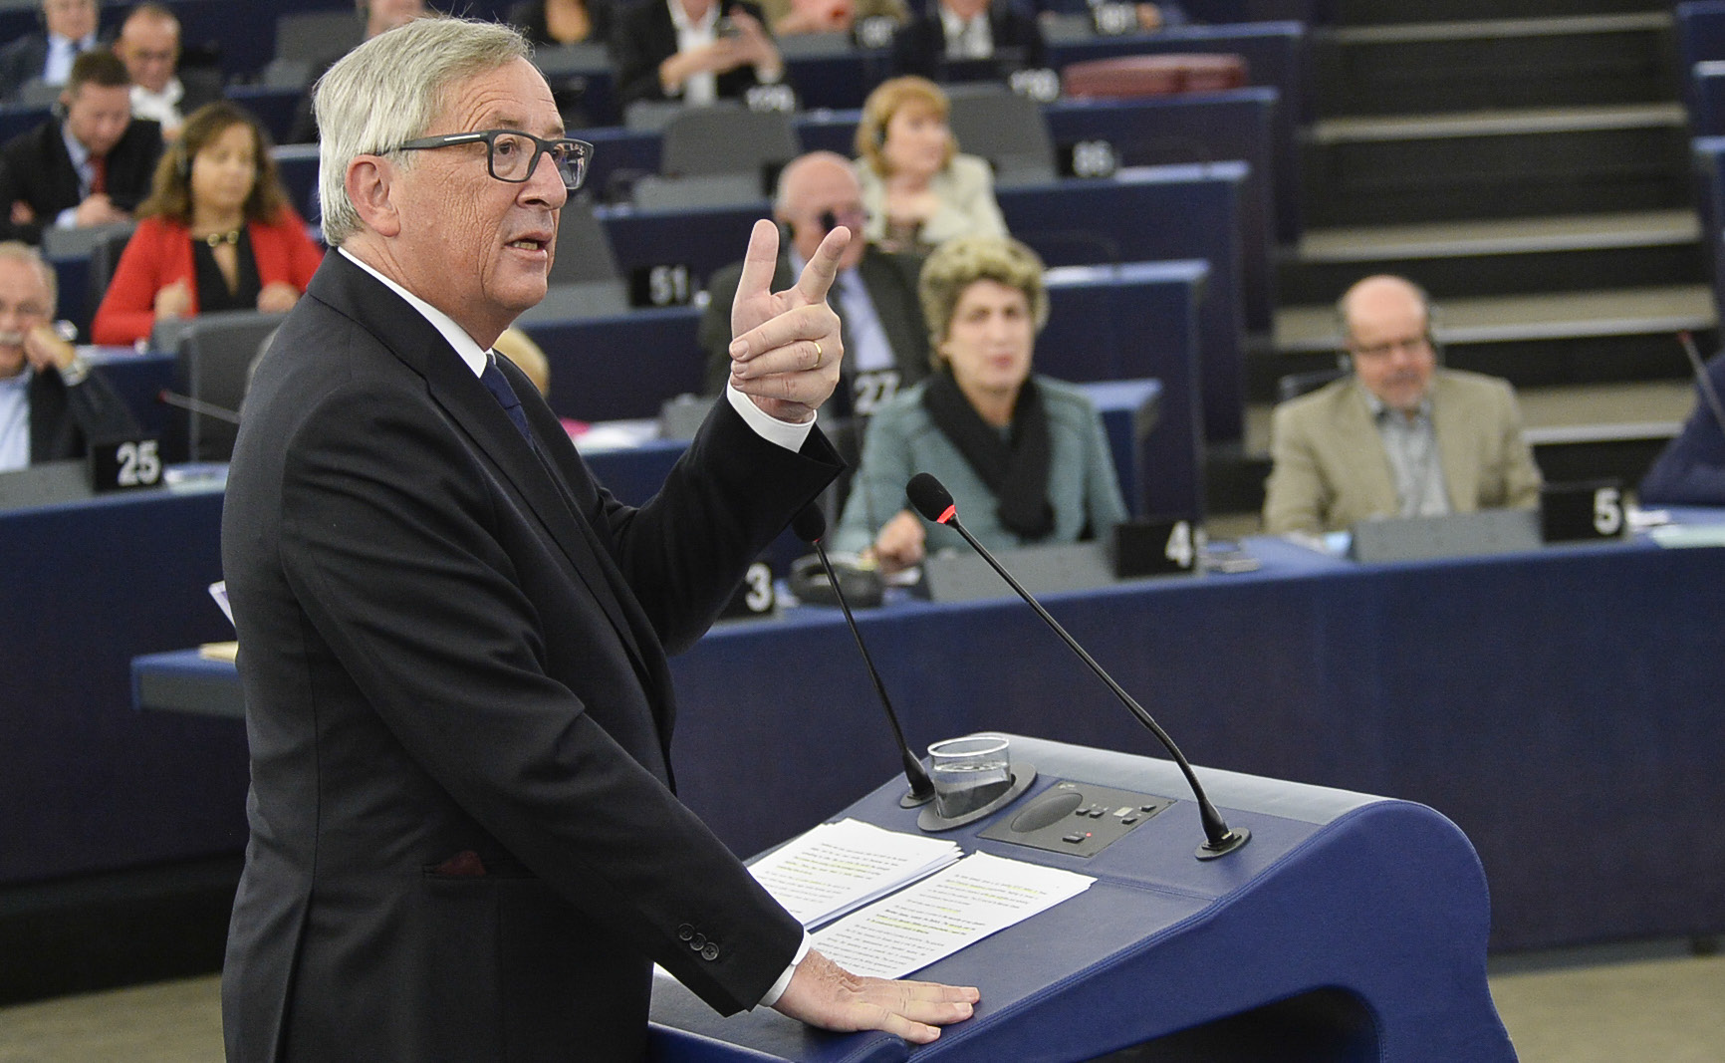
State of the Union address 14/9/2016
Connectivity should benefit everyone.
That is why today the Commission is proposing to fully deploy 5G, the fifth generation of mobile communication systems, across the European Union by 2025. This has the potential to create a further two million jobs in the EU.

Slide 5
Commission Study on 5G Impact
New Jobs: 2,4 million
Input-output analysis
Benefits of 5G introduction €113 billion
Identification and quantification of key socio-economic data to support strategic planning for the introduction of 5G in Europe - SMART 2014/0008

Slide 6
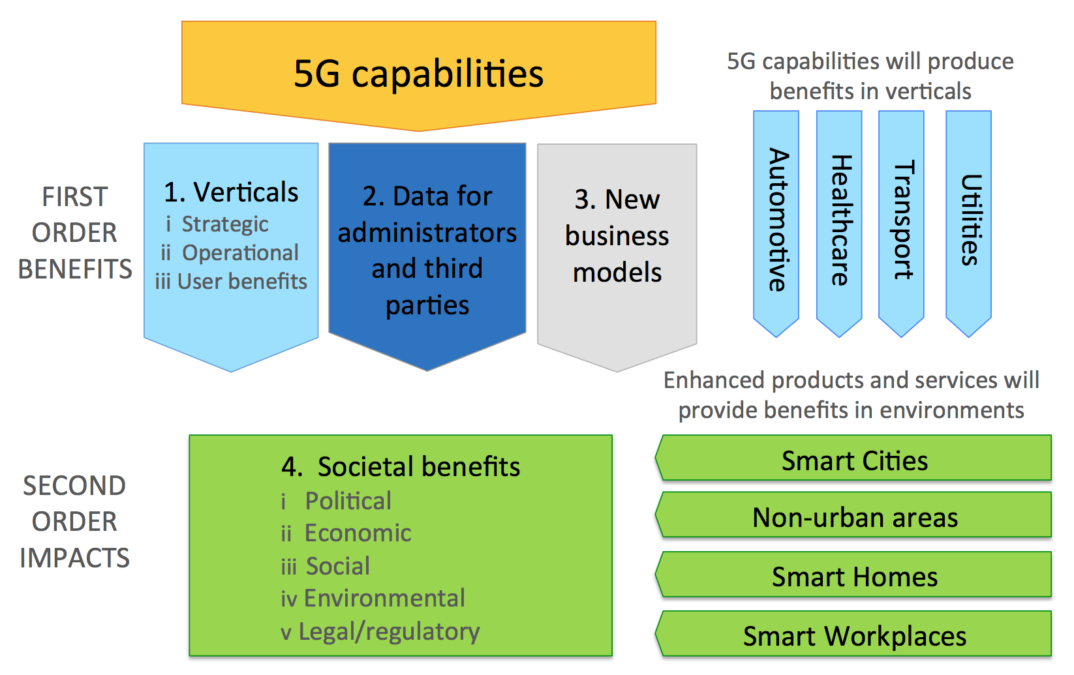
Commission Study on 5G Impact
Reference: Identification and quantification of key socio-economic data to support strategic planning for the introduction of 5G in Europe - SMART 2014/0008

Slide 7
Vertical headlines
Vertical & Environments Benefits
Verticals Benefits | Automotive (€ mn) | Healthcare (€ mn) | Transport (€ mn) | Utilities (€ mn) | Total (€ mn)
Strategic | 13,800 | 1,100 | 5,100 | 775 | 19,770
Operational | 1,800 | 4,150 | 3,200 | 2,700 | 11,850
Consumer | 13,900 | 207 | - | 3,000 | 17,110
Third Party | 13,700 | 72 | - | - | 13,770
Total | 42,200 | 5,530 | 8,300 | 6,470 | 62,500
Environment Benefits | Smart City (€ mn) | Non-urban (€ mn) | Smart Home (€ mn) | Workplace (€ mn) | Total (€ mn)
Economic | 4,000 | 2,200 | 720 | 14,500 | 21,420
Social | 4,100 | 8,300 | - | - | 12,400
Environmental | 22 | 38 | 609 | 16,100 | 16,770
Total | 8,120 | 10,540 | 1,330 | 30,600 | 50,590
Source: Identification and quantification of key socio-economic data to support strategic planning for the introduction of 5G in Europe - SMART 2014/0008

Slide 8
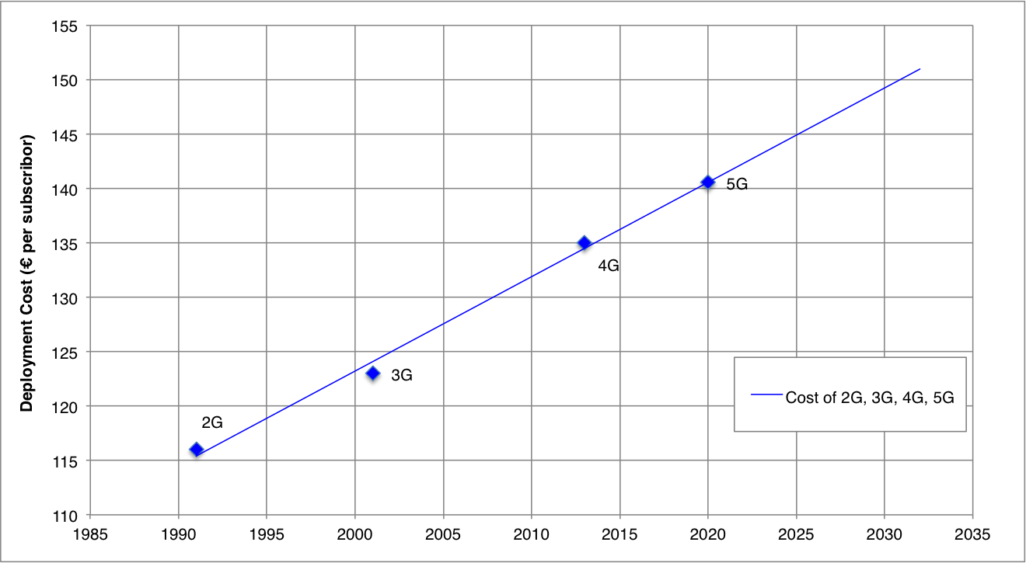
Vertical headlines
Cost of 5G Deployment
(on top of fixed broadband infrastructure investments)
This would equate to a total cost of 5G deployment in EU Member States of approximately €58 billion in 2025

Slide 9
5G Action Plan: Motivations
New EU Market potential, usages, actors
DSM support
Technology maturity
Acceleration of 5G agenda
Learning our lessons.

Slide 10
The 5G Action plan
  What:
  Industry deployment of advanced 5G networks as from 2020 in a coordinated manner throughout the DSM, as a strategic driver for EU competitiveness.
  How:
  Proposing to MS the timely implementation of a comprehensive set of operational steps to accelerate investments in the following areas: very dense cellular coverage, superfast fibre backhauling, vertical industry driven connectivity services, new digital innovation ecosystems.

Slide 11
Connectivity
5G Action Plan
Action plan for 5G
5G
Common roadmap for a coordinated deployment of 5G in 2020
"Keeping the EU ahead of the race"
Common EU calendar / coordinated national plans for commercial launch
"A 5G-ready Europe" - strategic pre-requisites:
Availability of spectrum - fast track for EU spectrum decisions re. 5G
Availability of fibre connectivity – fibre capacity for 5G backhauling
Reducing the cost of 5G deployment (emission limits, local taxes, ….)
"5G in support of Growth"
Commission as facilitator of cross-sectoral business synergies
Innovative ecosystems and collaboration
Pan-European 5G trials / pilot projects (Connected Driving Corridor…)
"Preserving 5G Global Interoperability for consumers"
  Promote common global standards

Slide 12
"Single Market" approach to EU 5G Introduction
Early 5G launch in selected areas
2018
Commercial launch of 5G services in at least one major city in all MS
5G in all urban areas and
Along main transport paths
2020
2025
Aggressive roll-out with geographical and sectorial focus
Coordinated/quasi-simultaneous launch throughout single market

Slide 13
5G Action Plan Timeline
National
5G Roadmaps
Common target
5G Launched
in all MSs
5G Everywhere
Spectrum allocation & assignment
5G Standardisation
Cross-border
pre-commercial
trials
…
We are
here!
Venture Capital support to innovative start-up in 5G key use sectors
…
Best practice + fibre planning
to boost "small cell" deployment
Continued substantial investments
in fibre infrastructure and "small cells"
2017
2018
2019
2020
2021
2022
2023
2024
2025

Slide 14
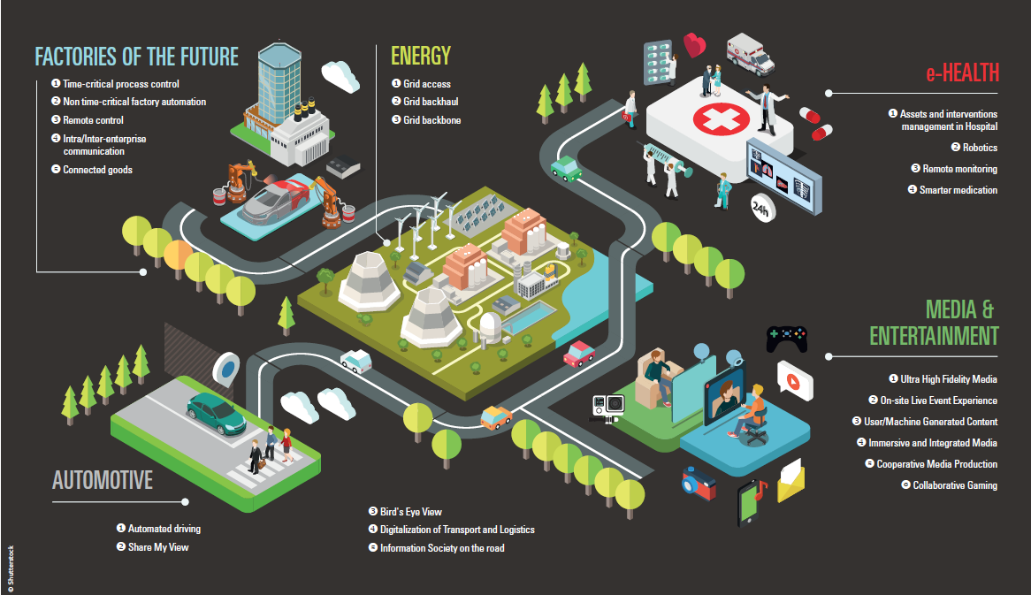
5G for the DSM:
"Pervasive fixed and mobile connectivity"

Slide 15
Supporting Actions: 5G PPP
5G Public Private Partnership launched in Dec. 2013
Objective-driven (technical, economic, social) ⇨ contractual KPIs / 700 M€ public funding 2014-2020 / 3500 M€ private investment
7 billion
7 trillion
0 latency
x 1000
90%
5G PPP Collaborative Achievements
https://5g-ppp.eu/white-papers/

Slide 16
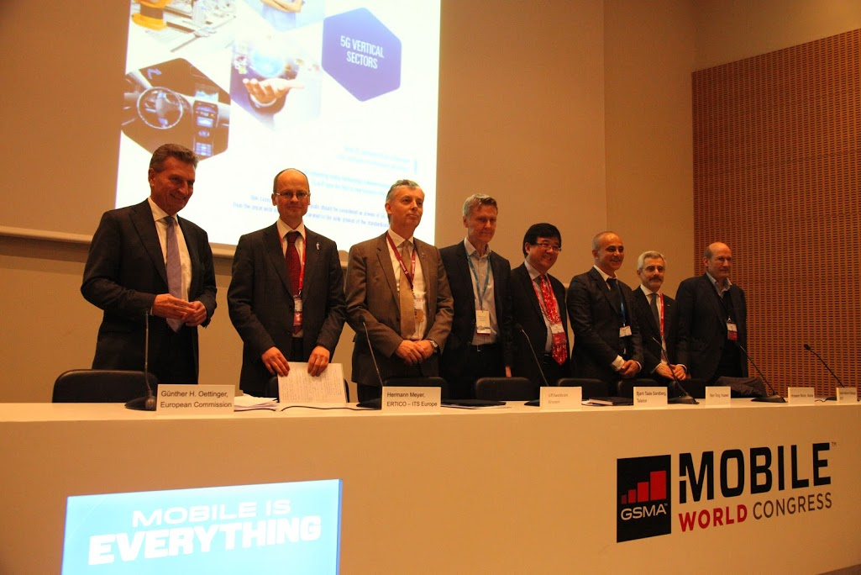

Moving on beyond Vision:
5G for verticals
Notes:
Launching the 5G PPP White Paper "5G serving vertical industries", in line with the previous keynote
Reflects EC commitment to place Verticals at the centre of 5G developments
Result of almost one year of work between 5G PPP ICT actors and vertical actors
Paves the way towards future 5G PPP R&I implementation across industries

Slide 17
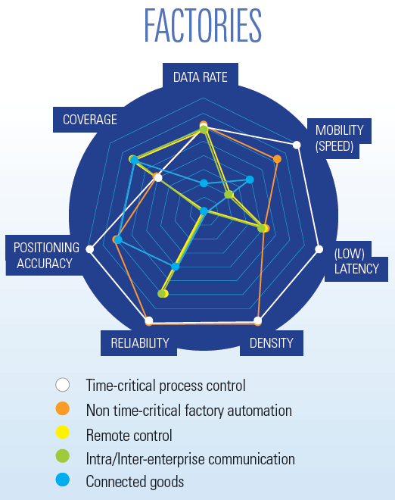
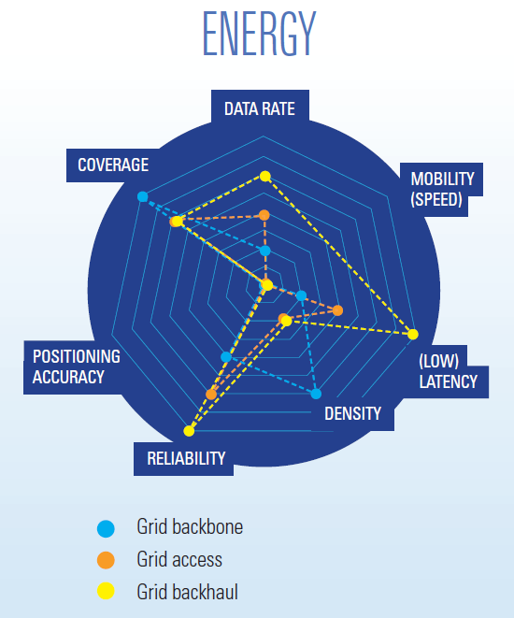
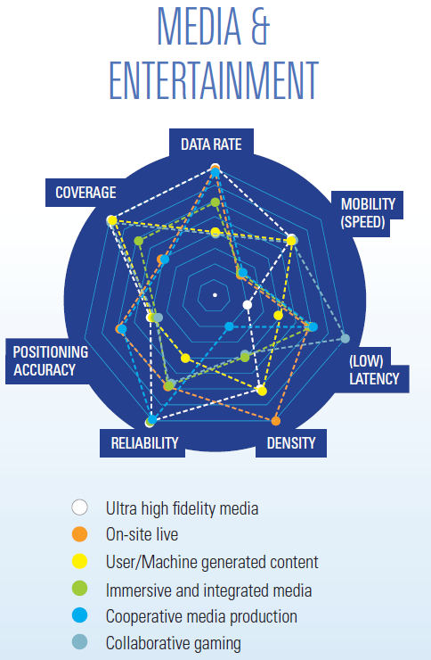
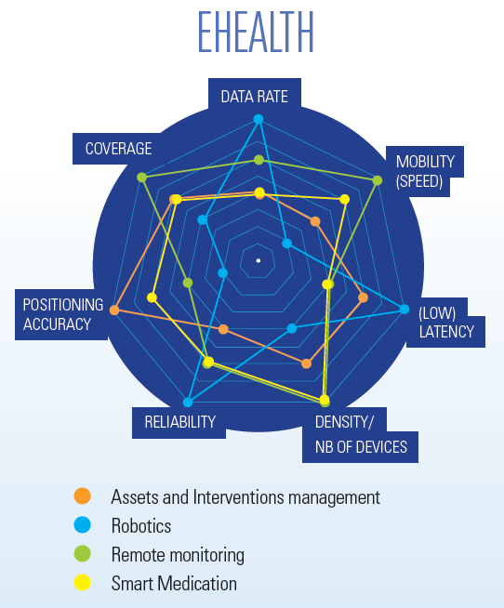
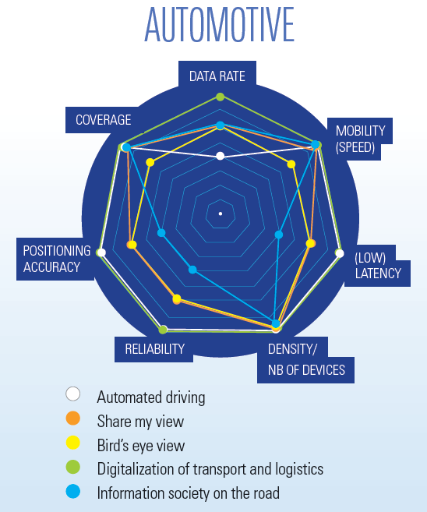
Vertical Requirements
Source: White Paper, "5G Empowering the Vertical Industries, February 2016.

Slide 18





Towards 5G PPP Phase 2
research and innovation actions
Critical technologies and Systems
Radio Network and Architectures
106 M€
Optical Core
SDN/NFV, architecture, net mgt;
R&I access nets (Taiwan)
advanced
5G network infrastructure
Support Actions
programme integration, monitoring
Innovation actions
Optical support to access
Network apps
40M€
3M€
Keys: Verticals, experiments, demos
Notes:
106 = 101 + 5 for targeted action Taiwan

Slide 19






Conclusions
5G is a global activity with high momentum
ITU-R developed a vision recommendation on IMT-2020 and beyond
5G PPP vision is complementary to other documents
5G PPP project portfolio addresses all major building blocks of 5G systems
Close cooperation with vertical sectors initiated
Different vertical use cases have different
  needs and
  technical requirements on 5G systems
  high flexibility required
5G PPP time plan in line with global activities on standardisation and regulatory activities
Horizon 2020 5G PPP Call 2 under preparation
Horizon 2020 is open for international participation
is inviting you to the
5G Global event in Rome, Italy
on November 9 and 10, 2016
Acknowledgement: The author would like to thank his colleagues for their contributions.
25/10/2016
Source: 5G Infrastructure Association.

