Slide 1


PERISCOPE: Standardizing and Orchestrating Looking Glass Querying
Vasileios Giotsas
vgiotsas@caida.org
Notes:
1

Slide 2
Purpose of this talk
Inform the operational community about Periscope.
Solicit feedback:
  Details that we may have missed
  Ways to make Periscope more useful
  Technical insights, usage statistics, historical data …
Encourage engagement and contributions
2
Notes:
2

Slide 3
High-level goals and principles of Periscope
Periscope unifies the discovery and querying of Looking Glasses under a uniform API
Respect resource limitations and preserve conservative query rates
Provide transparency and accountability in Looking Glass querying.
Be responsive and compliant to operators’ requests.
3
Notes:
3

Slide 4
Advantages of LG measurements
LGs are among the few public measurement tools that provide direct interfaces to routers:
  Access to non-transitive BGP attributes (e.g. LocPref).
  Co-located BGP and traceroute/ping monitors.
  Vantage Points at colocation facilities, IXPs, datacenters.
  Vantage Points in ASes not covered by other platforms
Motamedi, R., Rejaie, R., & Willinger, W. (2015). A Survey of Techniques for Internet Topology Discovery. Communications Surveys & Tutorials, IEEE, 17(2), 1044-1065.
A. Khan, T. Kwon, H.-c. Kim, & Y. Choi, “AS-level Topology Collection Through Looking Glass Servers,” in IMC ’13
4
Notes:
4

Slide 5
Problems with LGs
Lack of standardization and consistency:
  Disparate interfaces and output formats
Hard to discover and track:
  No centralized index of LGs, their locations and their capabilities
High attrition rates:
  Hard to maintain an up-to-date list of LGs
M. Stubbig, “Looking Glass API.” https://tools.ietf.org/html/draft-mst-lgapi-04, May 2016.
5
Notes:
5

Slide 6
Problems with LGs
Lack of standardization and consistency:
  Disparate interfaces and output formats
Hard to discover and track:
  No centralized index of LGs, their locations and their capabilities
High attrition rates:
  Hard to maintain an up-to-date list of LGs
Periscope implements a common querying scheme, indexing and data persistence features
M. Stubbig, “Looking Glass API.” https://tools.ietf.org/html/draft-mst-lgapi-04, May 2016.
6
Notes:
6

Slide 7
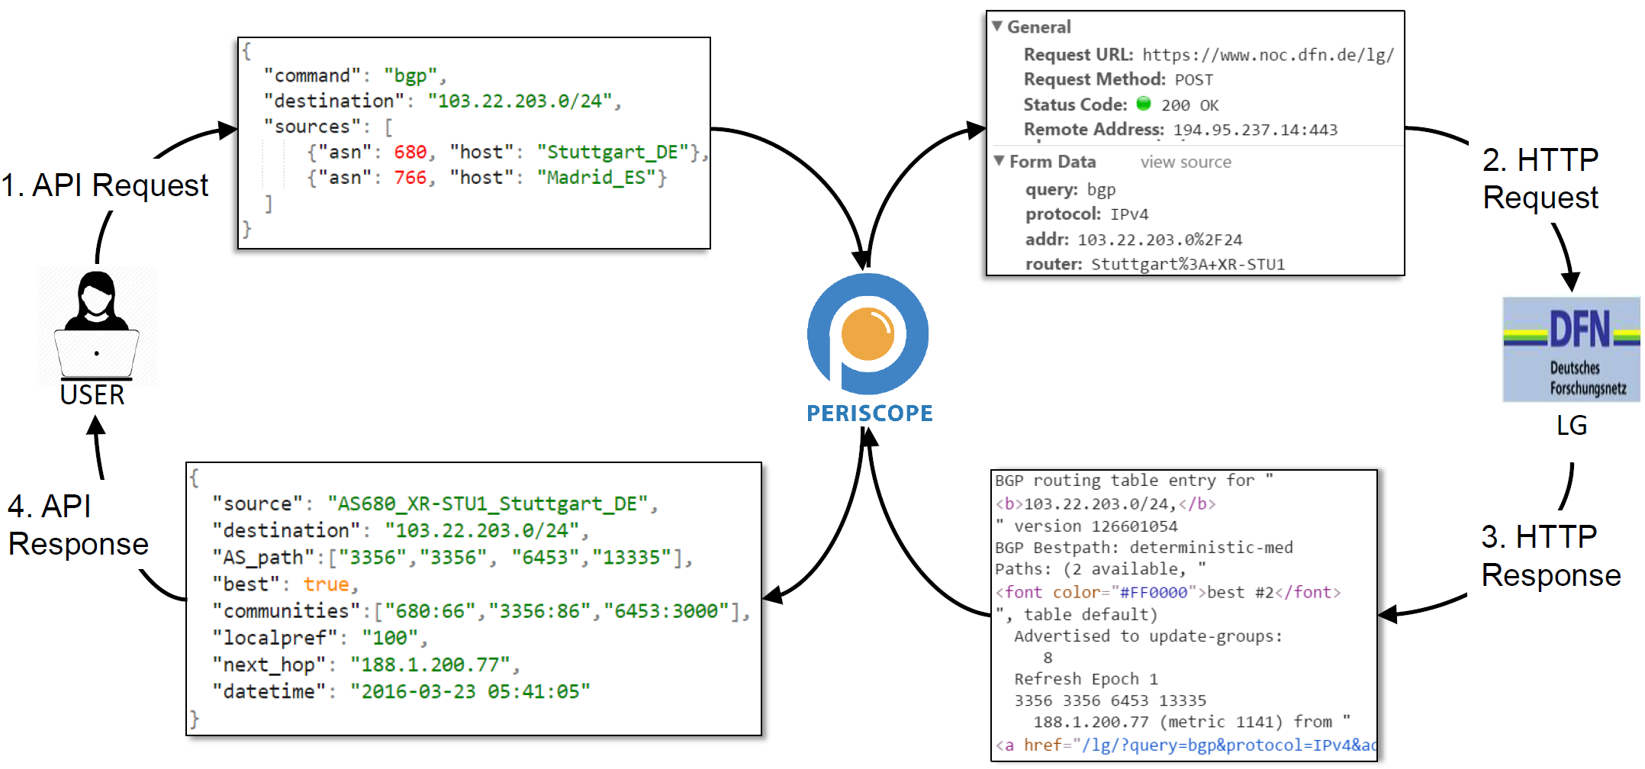
Periscope Workflow
7
Notes:
7

Slide 8
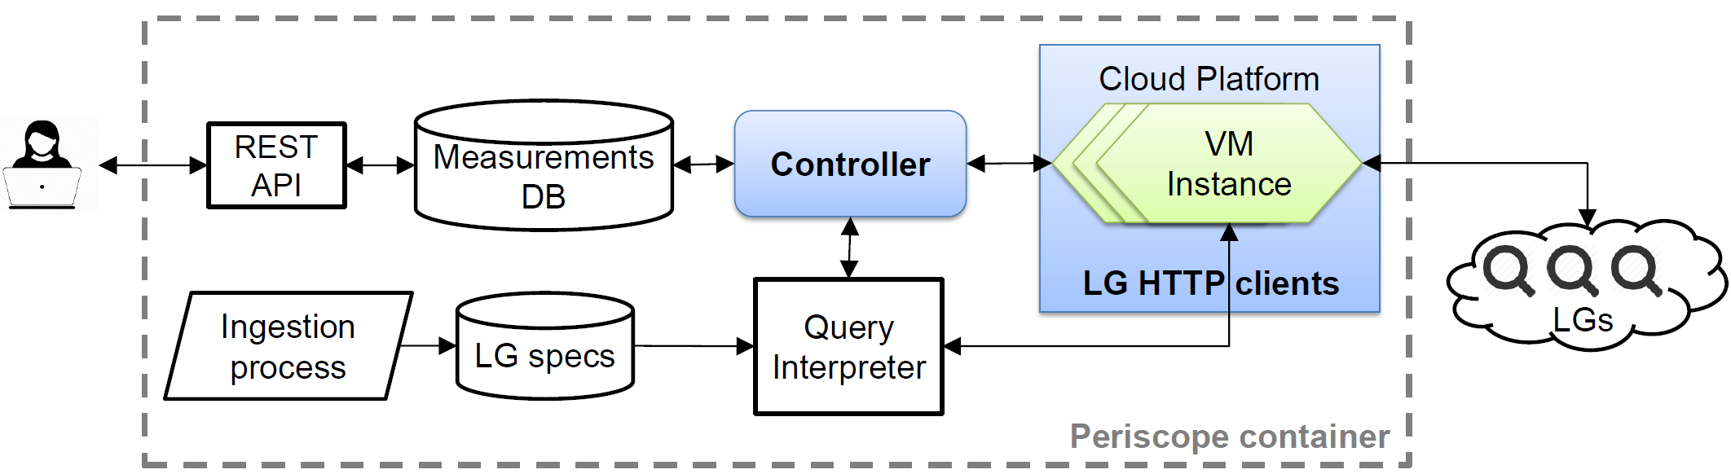
Periscope Architecture
For each Periscope User the controller allocates a different cloud-hosted VM instance to execute the user queries.
Each VM instance takes an IP address from the cloud operator’s address space.
The controller implements throttling of query rates.
8
Notes:
8

Slide 9
Periscope enforces per-user and per-LG query rate limits
Two limits control the rate of issued LG queries:
  User-specific: Each user can issue only 1 query per 5 minutes to the same LG.
  LG-specific: Each LG will execute up to 3 queries per minute from all the users.
A query is allocated if neither limit is exceeded.
Exponential back off when LGs respond with errors
9
Notes:
9

Slide 10
Transparency and accountability
Periscope sets three custom HTTP headers in every request:
  "X-Request-Origin: periscope"
  "X-Request-For:<user-ip>"
  "X-Request-Client:<gcloud OR aws OR ark>"
Periscope IPs configured with reverse DNS records.
Periscope assigns an LG client with a static IP address to each Periscope user to allow persistence identification.
10
Notes:
10

Slide 11
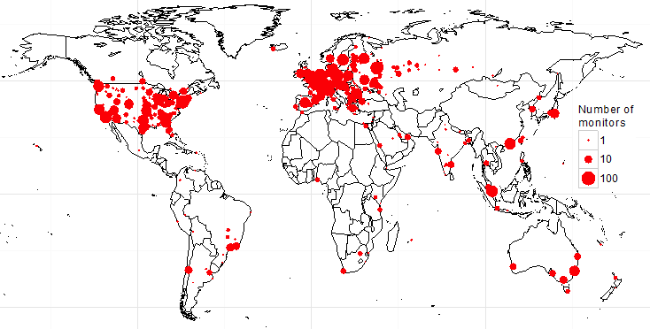
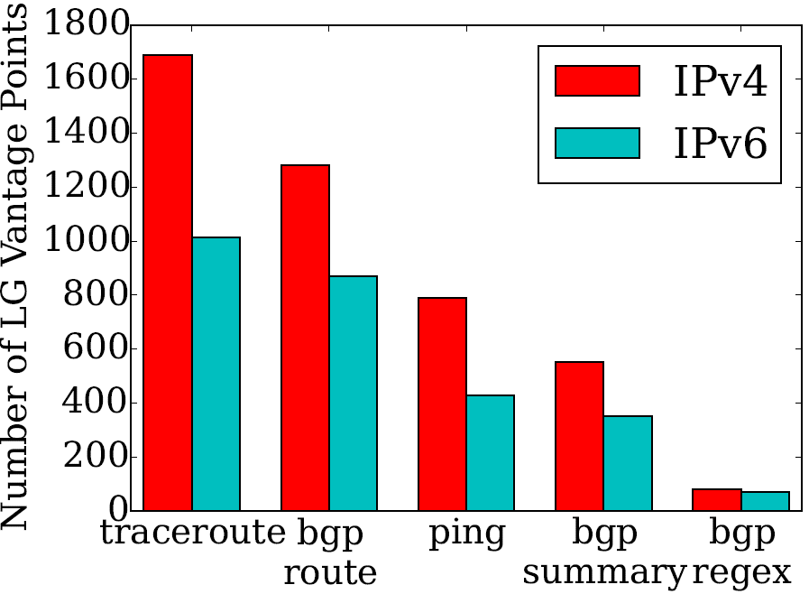
Coverage of Periscope LGs
572 ASNs with 2,951 VPs.
77 countries, 492 cities.
> 75% of VPs provide both traceroute and BGP.
> 60% of LGs support IPv6.
11

Slide 12
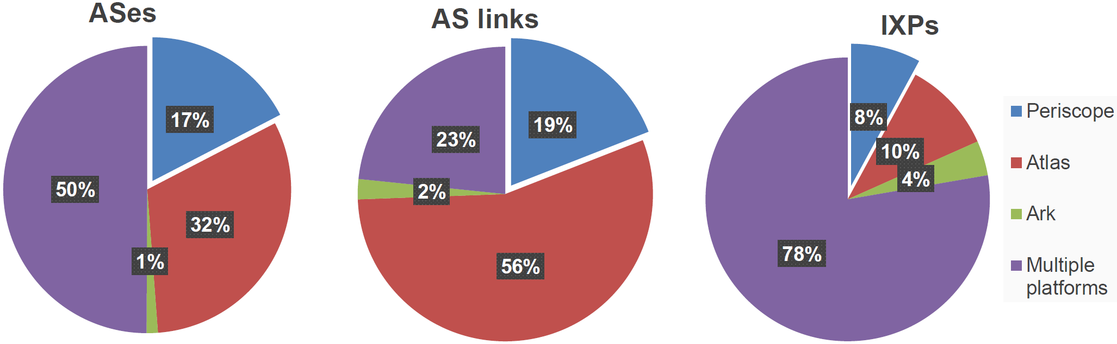
The topology observed by LGs is largely complementary to other platforms
Queried 2,000 randomly selected IPs from each LG and from each VP available in RIPE Atlas and CAIDA’s Ark
12
Notes:
12

Slide 13
Benefits
Easier to discover and query new VPs for reverse paths
Easier policing of Looking Glass usage through an access-control layer
Improved utilization and load distribution
Avoid redundant measurements by archiving and making public historical measurement data.
13
Notes:
13

Slide 14
Request for contributions
Please contribute feedback regarding:
  Per user query limits
  Global query limits
  Opt-in or opt-out requests
Utilization statistics and archived queries.
Funding, infrastructure support (VM instances, cloud computing credit).
14
Notes:
14

Slide 15


Conclusion
Periscope goals:
  Unify LGs under a uniform API.
  Enforce per-user and global query limits.
  Provide Transparency and accountability
Access request: periscope-info@caida.org
Documentation:
http://www.caida.org/tools/utilities/looking-glass-api/
15

Slide 16
BACKUP SLIDES

Slide 17



Support for multiple concurrent users requires multiple LG clients
Native LG querying
Single-client Periscope
✘
Multi-client Periscope
✔
☹
☹
1.1.1.2
1.1.1.2
1.1.1.2
1.1.1.2
1.1.1.1
1.1.1.2
LG client
LG client
LG client
Periscope
Periscope
2.2.2.1
2.2.2.1
2.2.2.2
LG
LGs use the users’ IP address to impose per-user querying quotas
Putting multiple Periscope users behind the same IP causes all the users to share the quotas of a single user
Using different client per user allows Periscope to provide the same querying quotas as native querying
17
Notes:
So, normally looking glasses identify users based on their IP address or based on unique HTTP sessions and apply the rate limits per user. In Periscope we need to provide a similar setup for concurrent users. If we put multiple users behind the same looking glass client then we limit multiple users to the querying quota of a single user. To provide the same querying quotas as native access to LGs we need to use a different looking glass client per user which will have a different public IP address. So the question becomes how to provide a different LG client for each user.
17

Slide 18

LG Ingestion Workflow
PeeringDB
LG URLs
Web Crawler
HTML forms
Manual inspection needed
Traceroute.org
http://www.phplg.com/
No
https://github.com/Cha0sgr/BGP-Looking-Glass-NG
LG templates
Automatic configuration extraction
Successful mapping
http://sourceforge.net/projects/klg
http://mrlg.op-sec.us/
Yes
https://www.gw.com/sw/stripes/
LG attributers
Health checker
18
Notes:
18

Slide 19
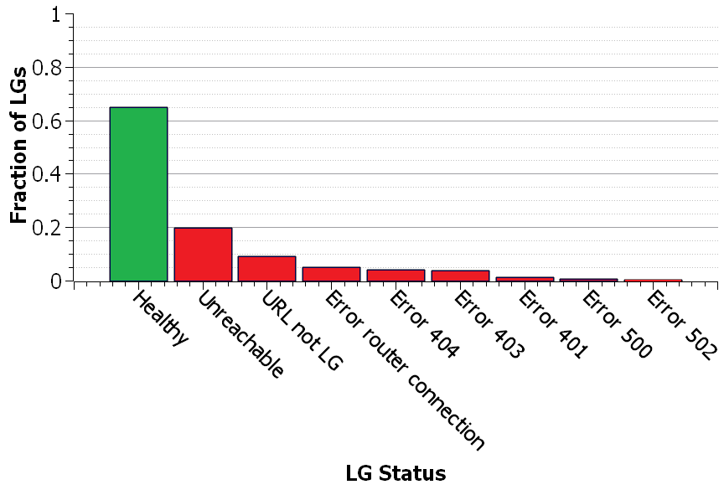
LG Ingestion Workflow
PeeringDB
LG URLs
Web Crawler
HTML forms
Manual inspection needed
Filters-out dead URLs & extracts HTML forms
Traceroute.org
http://www.phplg.com/
No
https://github.com/Cha0sgr/BGP-Looking-Glass-NG
LG templates
Automatic configuration extraction
Successful mapping
http://sourceforge.net/projects/klg
http://mrlg.op-sec.us/
Yes
https://www.gw.com/sw/stripes/
LG attributers
Health checker
19
Notes:
19

Slide 20
LG Ingestion Workflow
PeeringDB
LG URLs
Web Crawler
HTML forms
Manual inspection needed
Traceroute.org
http://www.phplg.com/
No
https://github.com/Cha0sgr/BGP-Looking-Glass-NG
LG templates
Automatic configuration extraction
Successful mapping
http://sourceforge.net/projects/klg
http://mrlg.op-sec.us/
Yes
https://www.gw.com/sw/stripes/
Automatically extracted LG specifications used to interpret API calls to LG queries
LG attributers
Health checker
20
Notes:
20

Slide 21
Load Distribution among LGs
AS3356 (High query load)
AS680 (Low query load)
21

Slide 22
Load Distribution among Platforms
AS680 (RIPE Atlas probe)
AS680 (Looking Glass)
22

Slide 23
Case study: ARTEMIS
23
G. Chaviaras et al. ARTEMIS: Real-Time Detection and Automatic Mitigation for BGP Prefix Hijacking. ACM SIGCOMM 2016

