Slide 1
CDAR
Continuous Data-driven Analysis of Root Stability
Progress report
DNS WG Ripe 73
Jaap Akkerhuis (NLnet Labs)
DISCLAIMER: All data subject to change

Slide 2
CDAR Study
Objective
Analyze the technical impact of the introduction of new gTLDs on the stability & security of the root server system
Approach
  Data-driven, using wide variety of DNS data
    RSSAC002, DITL ‘13, ‘14,`15 (, ‘16), RSO’s PCAP and DSC data,
    ATLAS / DNSMON, Zone File Repository, gTLD Registry reports,
    specific tools and public data sources
  Interaction with the broader tech community
    ICANN and advisory committees, RSOs, DNS-OARC, IEPG/IETF
  Using and expanding previous studies of RSS behavior
    DITL papers, L-Root scaling report, Name Collision report, …
    DNS Health reports and DNS threat analysis papers

Slide 3
Breaking news!
The Draft Report has just been send to ICANN
Public comment period will start soon

Slide 4
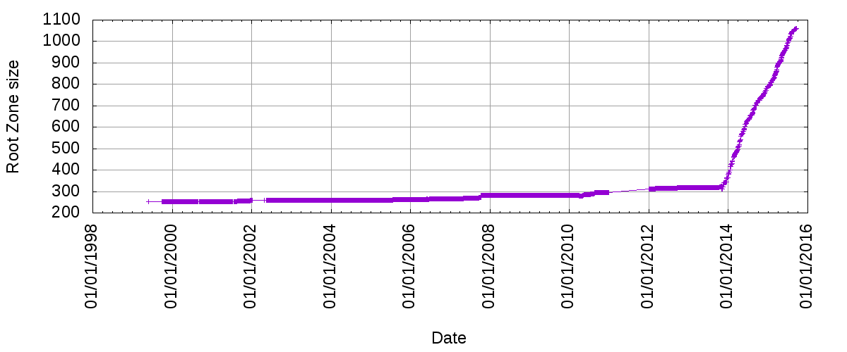
Hockey stick grow

Slide 5
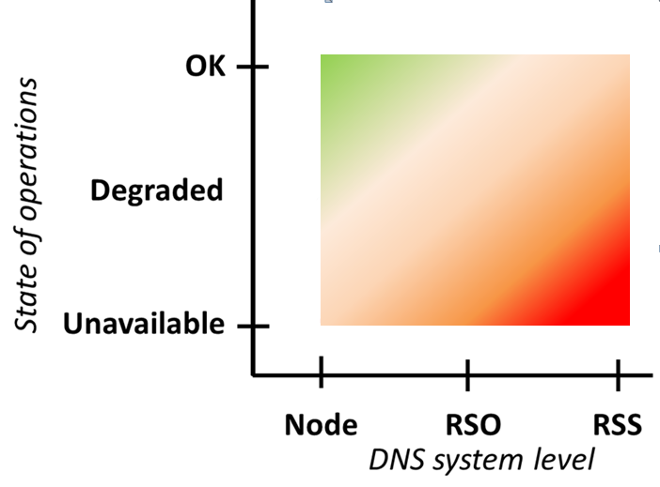
Stability of the Root Server System
Stability levels
Illustration of the distinction between macroscopic and microscopic scale for RSS stability
Example of RSS stability level:
Nov./Dec. ‘15 attack traffic

Slide 6
Possible Impact of New gTLD
Analysis of a range of RSS stability indicators
  As observed from the ‘outside’
RSS stability
Operational stability
DNS Data correctness
Missing responses
Response time stability
Query rate stability
Broken chain
Accuracy of root data
Valid queries
Incidental queries
Invalid queries
Zero-error
Consistency

Slide 7
Precaution: Limitations of Data Used
Limited data accuracy
  Measurement breakdowns don’t always add up to the total
  Different data collection methods lead to different results
Incomplete
  Collected data sets are not always complete
  Not all relevant partners contribute to RSSAC002, DITL etc
  History of some data sets is relatively short
Lack of standardized data format
  Different sources use different data formats and collection
  Is improving with RSSAC002 and DITL

Slide 8
CDAR Analyses

Slide 9
CDAR Analyses Presented Today
What is impact of increased number of TLDs on the query rate to the root?
Is the ratio between #domains in a TLD and the query rate to the root comparable for New gTLDs and other TLDs?
  Are cache hit rates for New gTLDs comparable to cache hit rates for other TLDs?
What is the impact of a new gTLD’s initial delegation in the RZF on the query rate to the Root (in the delegation period)?
  What is the impact of a new gTLD’s initial delegation on the RTT?
Do DNSSEC validation errors (broken chain) occur more frequently for New gTLDs, than for other TLDs?
  What is the behaviour of resolvers with validation errors?
Does the query type distribution for queries to new gTLDs differ from the query type distribution for queries to other TLDs?
Is there a geographic affinity for geographic new gTLDs?

Slide 10
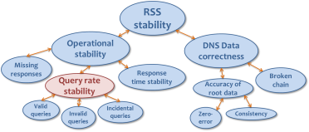
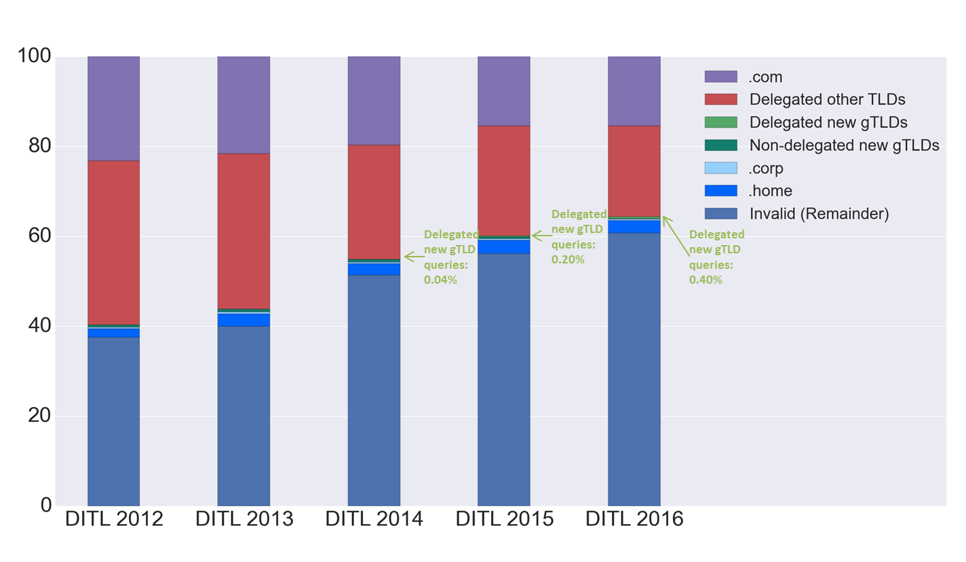
New gTLD Queries to the Root
The percentage of queries to New gTLDs has increased over time, but is still very low compared to other queries
Using DITL data offers possibility
to relate results to period prior
to new gTLD program
“Valid queries”
“Invalid queries”
A note on historic “invalid queries”:
F-root analysis Jan2001: %Invalid = 20%
F-root analysis Oct2002: %Invalid = 19,6%
DITL Mar2009: %Invalid ≈ 30⁺ %

Slide 11
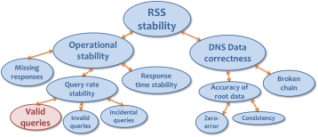
Rule of Thumb for Valid Query Rates
Data shows that a TLD’s valid query rate to the root is ‘bound’ by the number of domains in the TLD
  Example from DITL’15, K-root data:
More in general, this ratio rarely exceeds 10
  For any TLDs in recent H-Root data sets
  For new gTLDs the ratio is lower than for other TLDs
TLD | Nr. of queries / TLD | Nr. of domains / TLD | Query/domain ratio
.com | 779.171.677 | 120.585.440 | 6,46 E+00
.org | 91.095.714 | 10.569.583 | 8,62 E+00
.cn | 51.949.760 | 11.678.026 | 4,45 E+00
.br | 15.696.021 | 3.568.492 | 4,40 E+00
.club | 651.082 | 202.519 | 3,21 E+00
.xyz | 420.885 | 842.340 | 5,00 E-01

Slide 12
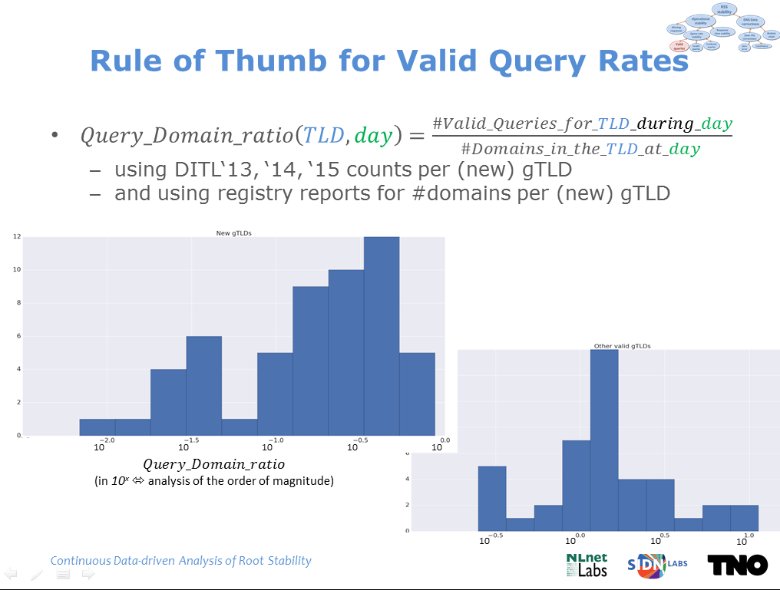
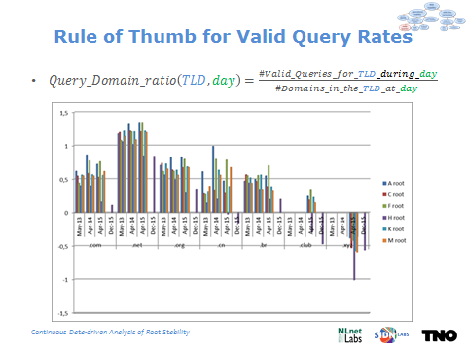
Rule of Thumb for Valid Query Rates
  A statistical rule of thumb
    Intuition: #valid TLD queries to the root is ‘bound’ by the TLDs ‘popularity’ (in terms of #domains)
    No DNS rational found for this observation
  This observation might provide an easily verifiable bound on valid queries to the root

Slide 13
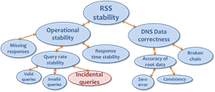
Impact of Initial Delegation (Query Rate)
The volume of root traffic for a new gTLD often decreases significantly after delegation (gTLDs A and B), but sometimes also increases (gTLD C) or increases temporarily (gTLD D)

Slide 14
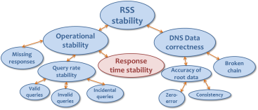
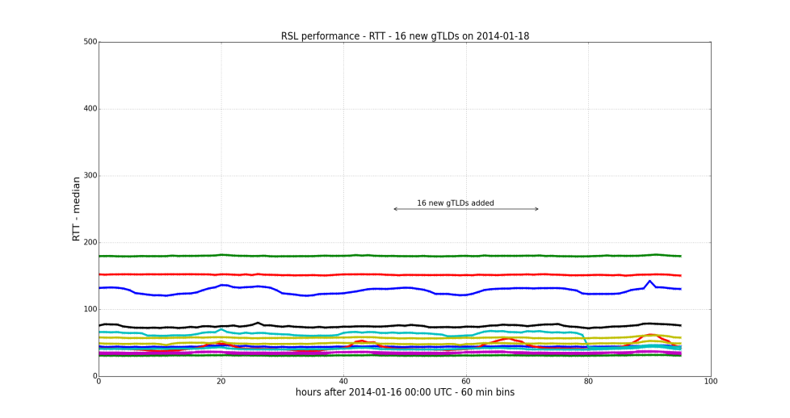
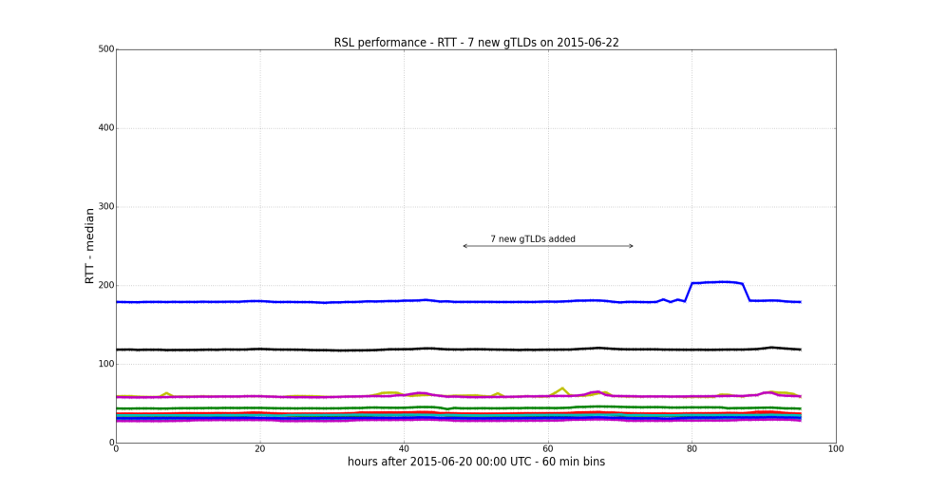
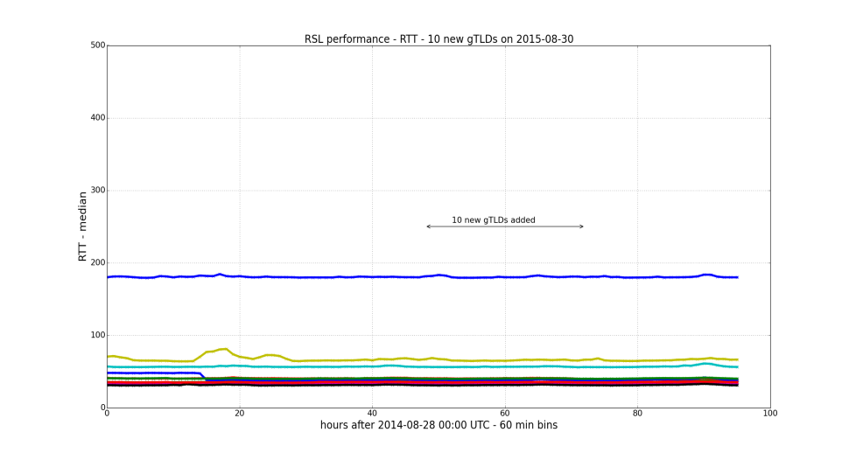
Impact of Initial Delegation (RTT)
RTT is not significantly affected after delegation of New gTLDs to the RZF
Considering 22 days in which 7 or more new gTLDs were delegated
Using RTT measurements from Atlas RIPE to all root servers
16 new gTLDs delegated on Jan 18, 2014
7 new gTLDs delegated on Jun 22, 2015
In general changes in the RTT before and after delegation are minor, both up and down
10 new gTLDs delegated on Aug 30, 2015

Slide 15
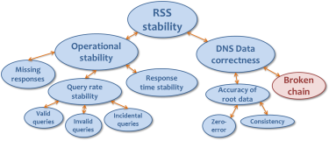

Impact on DNS Data Correctness
DNSSEC broken chain validation
  Structurally no more failures for new gTLDs than for other TLDs
  Some single failures on startup for new gTLDs
  https://meetings.icann.org/en/presentation-dnssec-monitoring-07mar16-en

Slide 16
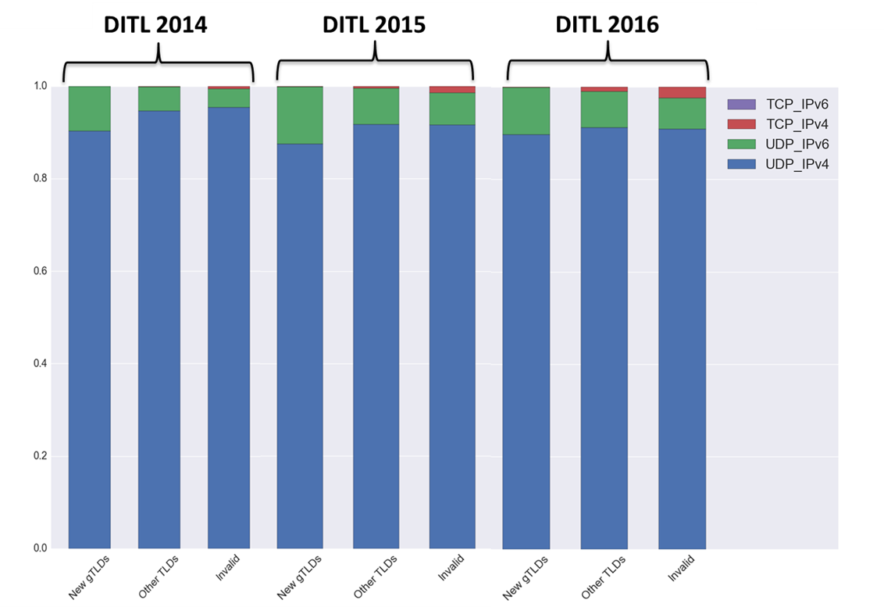
Query type distribution (by transport)
New gTLDs: queries to new gTLDs who are delegated at the time of the DITL set.
Other TLDs: queries to other TLDs who are delegated at the time of the DITL set.
Invalid: queries to names that have not been delegated.

Slide 17
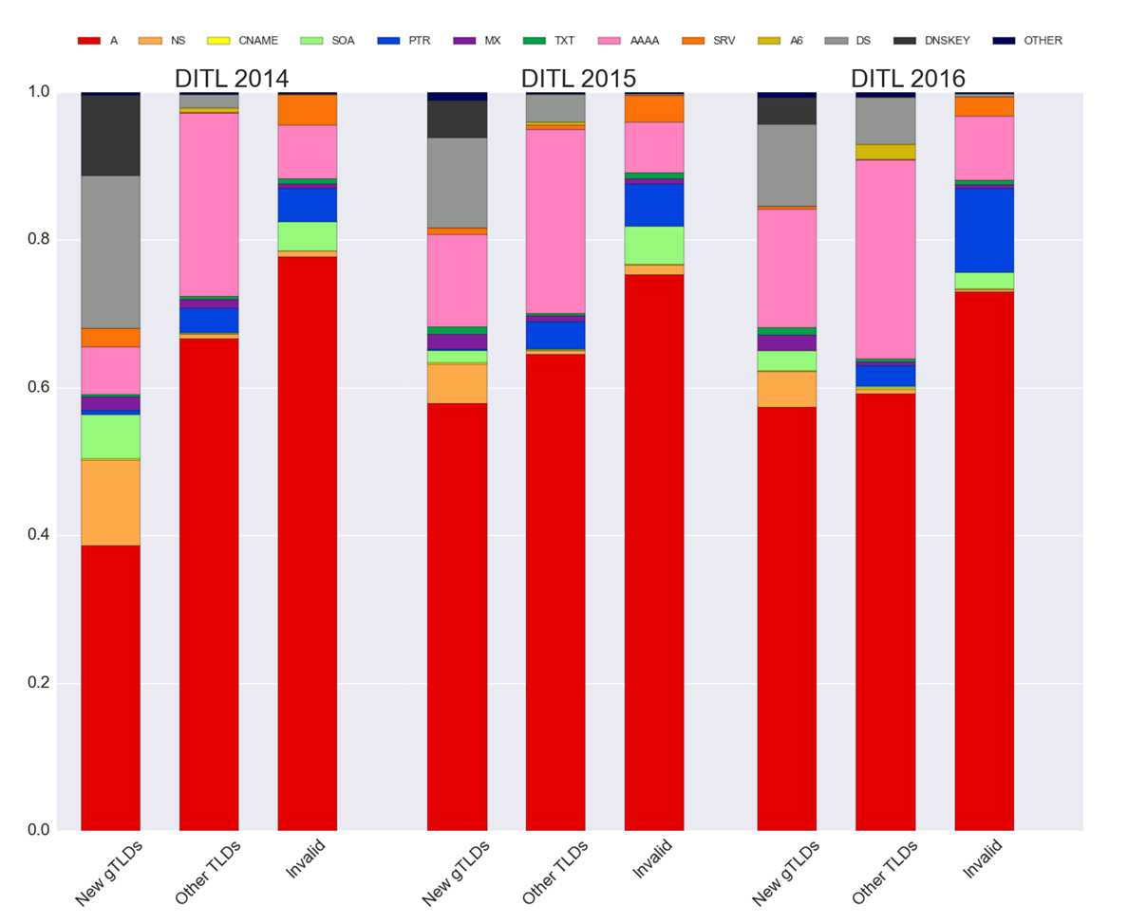
Query type distribution (by RRType)
New gTLDs: queries to new gTLDs who are delegated at the time of the DITL set.
Other TLDs: queries to other TLDs who are delegated at the time of the DITL set.
Invalid: queries to names that have not been delegated.

Slide 18
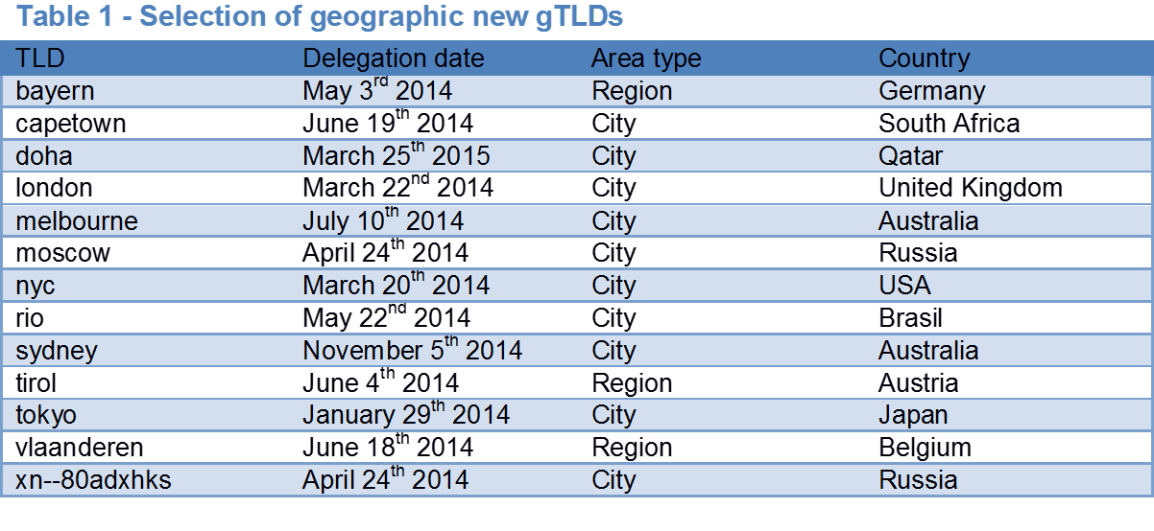
A selection of geographic new gTLDs
The DITL data sets differentiate into different anycast nodes, for a subset of Root Servers.
For some of these Root Servers, the anycast node names can be mapped to specific geographic locations. This allows us to use the DITL sets to derive query counts (split out per TLD) per location.

Slide 19
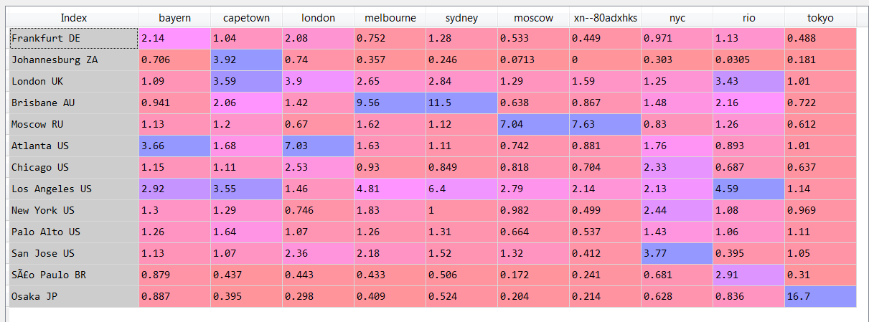
F-root, DITL 2016
Within the anycast node in Frankfurt, the fraction of queries going to .bayern is 2.14 times the fraction of all F-root queries going to .bayern.
A subset of F-root server anycast node locations
The fraction of queries to a geographic new gTLD is higher than average in an anycast node whose location is in the TLD-related country (geographic affinity)
The highest increase is visible for .tokyo in the Osaka anycast node. But even there the fraction of queries going to .tokyo is microscopic: 0,015%

Slide 20
Observations about data
DITL data
  ‘Umwelt’ changes faster then current sampling
  Data gets lost
  History gets lost
    Geographic info gets quickly unreliable

Slide 21
SAC046
Recommendation (4): ICANN should update its "Plan for Enhancing Internet Security, Stability, and Resiliency," to include actual measurement, monitoring, and datasharing capability of root zone performance, in cooperation with RSSAC and other root zone management participants to define the specific measurements, monitoring, and data sharing framework
DC: inability to obtain sufficient information to perform the modeling
KC & Vixie: inability to obtain sufficient information to perform the modeling

Slide 22
Suggested Next Steps
Challenges for the DNS community:
  Continuous improvement & standardization of data collection
    Sanity checking of data is hard
  More continuous measurement
  More relevant detailed data
    Long term H-root data was an “accident”
  Better comparable public data
    Noticed “phase errors” in 2014 DITL data
  Better sample frequency

Slide 23
Summary
Data quality varies and completeness can be improved
  Encouraging is that standardization of data collection (DITL, RSSAC002) is improving
  Collecting & analyzing per-TLD data provides new insights
Preliminary conclusion
  So far, we did not observe significant stability or security impact of new gTLD on RSS scale
  NewGTLD traffic dwarfed by HOME/CORP/LOCAL traffic
  In microscopic view some impact of new gTLDs is observed
    query rate fluctuations / DNSSEC validation errors around initial delegation
  Some geographic affinity for geographic new gTLDs is observed, but fraction of traffic to such new gTLDs remains insignificant

Slide 24
Questions and Discussion
CDAR Project Team
Bart Gijsen (TNO)
Benno Overeinder (NLnet Labs)
Cristian Hesselman (SIDN)
Daniël Worm (TNO)
Giovane Moura (SIDN)
Jaap Akkerhuis (NLnet Labs)
Coordinator
Bart Gijsen (Msc.)
+31 6 53 72 52 18
bart.gijsen@tno.nl
CDAR Home: http://www.cdar.nl

