Slide 1
The Magic of Stenography
Mary MCKeon, RMR, CRR, CBC

Slide 2
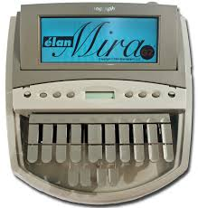
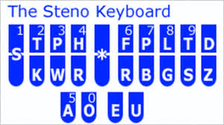
18 Letters
24 Keys

Slide 3
Shorthand on a machine
Different combinations make different words and sounds
Can press a lot of keys at the same time
It’s how often I hit the keyboard (how many times hands go up and down) as opposed to how many keys I can hit

Slide 4
Can make any outline represent any word or phrase you want
/STAEPBLD - UNTRANSLATE
Average person about 200 words a minute
Some at RIPE Meeings: about 300 words a minute!
Can’t get the words out fast enough!

Slide 5
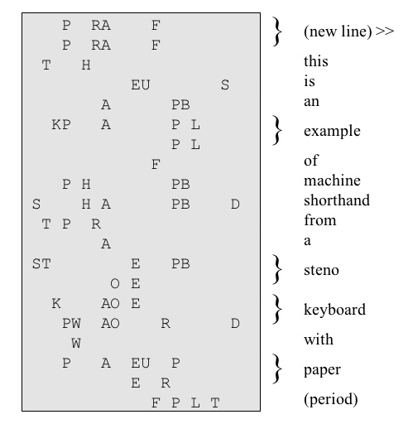

Slide 6
What we do at a RIPE Meeting:
One writer at the machine
One “scopist” in another room putting words and phrases in dictionaries with correct spelling, etc.
First full meeting was RIPE 56 in Berlin. Plenty of untranslates, all the acronyms and names

Slide 7
What we do at a RIPE Meeting:
Now, dictionaries have gotten larger and we are somewhat familiar with the technical jargon
We still don’t have a clue what you are talking about but we take it down!!
An awful lot of concentration is needed and it’s tiring!!

Slide 8
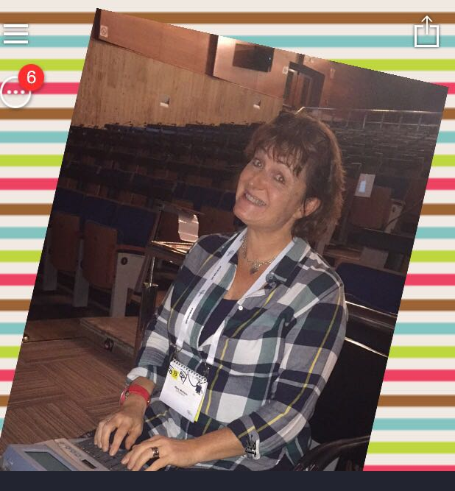
Monday morning at RIPE Meeting

Slide 9
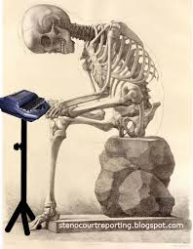
…Friday afternoon

Slide 10
