Slide 1

SoloWAN: open source WAN optimization
Universidad Politécnica de Madrid (UPM)
David Fernández, F. Javier Ruiz, Luis Bellido, Raúl Álvarez, German Martín, Carlos Vega, Roberto Montero, Mattia Peirano, Francisco Huertas, Antonio Celorio, Juan Carlos Dueñas
solowan@dit.upm.es
Center for Open Middleware
Universidad Politécnica de Madrid

Slide 2
Contents
WAN optimization techniques
SoloWAN project
Use case scenarios and results
Virtual testbeds scenarios based on VNX
Notes:
Software libre para la optimización WAN (4m)
Mencionar WanOS, aunque fuera del estudio inicial
OpenNOP-SoloWAN (8m)
Características. Arquitectura. Docker.
Pruebas y resultados (BBDD, WanOS, WCCP)
Entornos virtuales de pruebas: VNX (3m)
Arquitectura escalable (5m)
Balanceador SDN
Pruebas y resultados (WCCP)
Resumen de logros (2m)
Conclusiones y trabajos futuros (3m)

Slide 3

WAN Optimization Techniques
Objective: improve WAN links performance
  WAN link characteristics: lower bandwidth, higher delays, higher cost
Techniques:
  Compression, Deduplication (or dictionary based compression), TCP optimization, Application caches, etc.
Data
Center B
Data
Center A
WAN

Slide 4

WAN optimization based on deduplication
Data
Center B
WAN Optimization Devices
Data
Center A
WAN
WOC
WOC
WOC B Dictionary/cache
WOC A Dictionary/cache
Notes:
New algorithms, such as dictionary based compression, also known as deduplication, use a different approach to further reduce the redundancy among different connections. (10s)
(CLICK) Basically, every packet transmitted is stored in a dictionary in both optimizers. (5s)
~17 s

Slide 5
WAN optimization based on deduplication
Data
Center B
Info block replaced by a short symbol (hash)
Data
Center A
WAN
WOC
WOC
Redundancy
info block detected
WOC B Dictionary/cache
WOC A Dictionary/cache
Notes:
(CLICK) Whenever a new packet arrives at the inbound optimizer, the dictionary is scanned (CLICK) to find blocks of information that have already been transmitted. If found (CLICK), these blocks are substituted by a short symbol or hash, thus reducing the volume of information transmitted. (16 s)
~18 s

Slide 6
WAN optimization based on deduplication
Data
Center B
Data
Center A
WAN
WOC
WOC
Original
info block recovered
Original
info block recovered
WOC B Dictionary/cache
WOC A Dictionary/cache
Notes:
(CLICK) When the packet arrives at the outbound optimizer, the hash is replaced by the original information before forwarding it to its final destination. (10 s)
~12 s

Slide 7
SoloWAN rationale
Commercial WOC solutions:
  Complex systems
  Scalability and elasticity issues
  High cost in terms of equipment and licensing
What about open source software (OSS) based WAN optimization solutions?
Notes:
Ver informe de Gartner: “Magic Quadrant for WAN Optimization”

Slide 8


SoloWAN initial objective
Evaluate the use of Open Source Software (OSS) for WAN optimization in the context of corporate communications
  Study of available solutions
  Creation of virtual and real testing environments
  Test OSS solutions and conclude recommendations
Any OSS mature solution found?
YES
NO
Objective reoriented to enhance OSS OpenNOP WAN optimization platform with:
  Efficient deduplication algorithm
  Scalable and elastic architecture running on standard hardware
Notes:
Ver informe de Gartner: “Magic Quadrant for WAN Optimization”

Slide 9
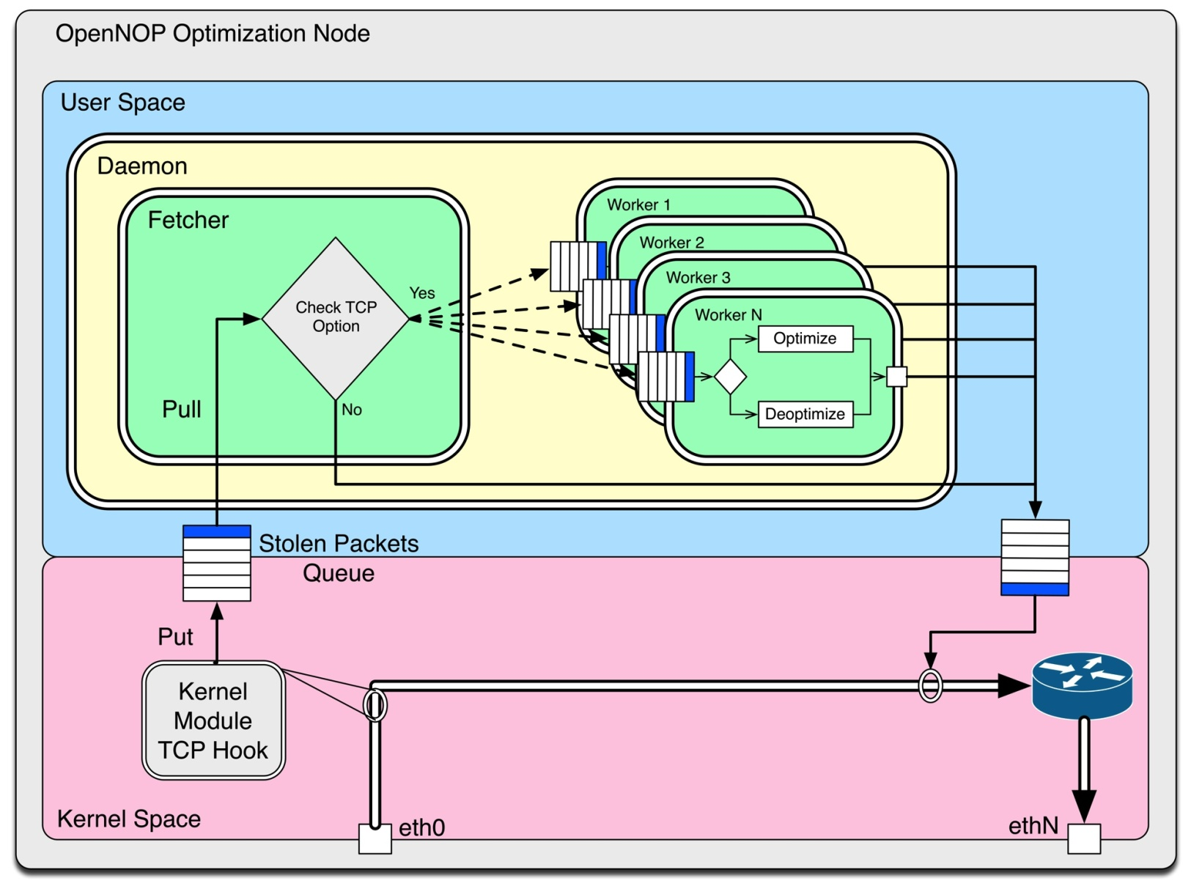
SoloWAN Architecture
Based on Open Network Optimization Platform (OpenNOP, www.opennop.org)
Linux
User Space
Linux kernel module + application in user-space
Use of netfilter to capture traffic
Multithread (worker)
Written in C
Linux
Kernel

Slide 10
Deduplication Algorithm
Deduplication functionality based on:
  Neil T. Spring and David Wetherall. A Protocol-Independent Technique for Eliminating Redundant Network Traffic. SIGCOMM '00.
Main problem: how to efficiently identify repeated content?
  Computationally intensive
Simplification:
  Compare only fixed size blocks (64 bytes) at a reduced number of positions (32)
  Calculate a hash (fingerprint) for each block inside a packed and store it in the dictionary together with the packet
  Once a match is detected, look around matching block to see if more bytes match
?
=
New packet to Tx
Transmitted packet cache

Slide 11
SoloWAN characteristics
Algorithms:
  Compression (originally included in OpenNOP)
  Deduplication
  Deduplication + Compression
Available as a linux daemon or as a docker container
First version released in nov 2014
  https://github.com/solowan/solowan
Multithread architecture with dictionaries shared among threads
Demo virtual machine available with VNX based virtual scenarios
Wireshark Plugin to decode SoloWAN packet format

Slide 12

SoloWAN Scenarios
  Optimizer-in-the-Network (oitn)
  End-to-End (e2e)
WAN
Optimizer1
Optimizer2
Application
Application
WAN
R1
R2
Opennopd
opennopd
h1
h2
Process or docker container

Slide 13
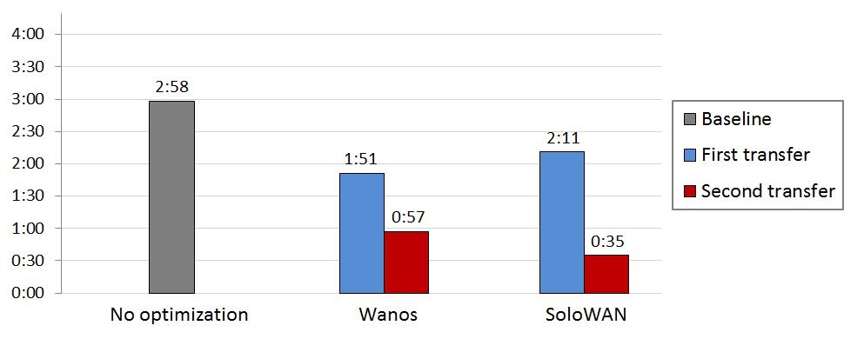
SoloWAN Tests
Mainly tested with FTP, HTTP and access to mysql databases
  Not suitable for encrypted traffic
Using benchmark files from Silesia Corpus:
  Set of representative files (de 6 a 51 M)
  http://www.data-compression.info/Corpora/SilesiaCorpus/

Slide 14
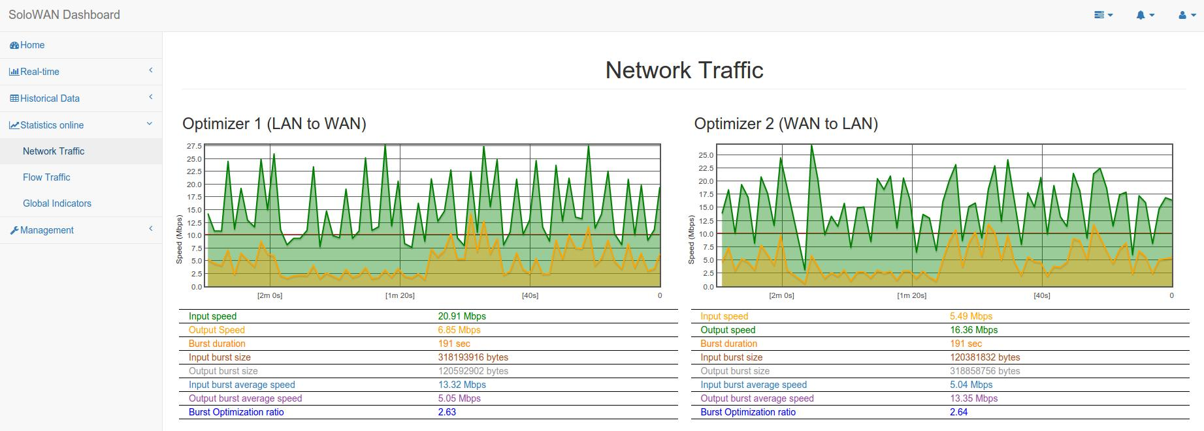
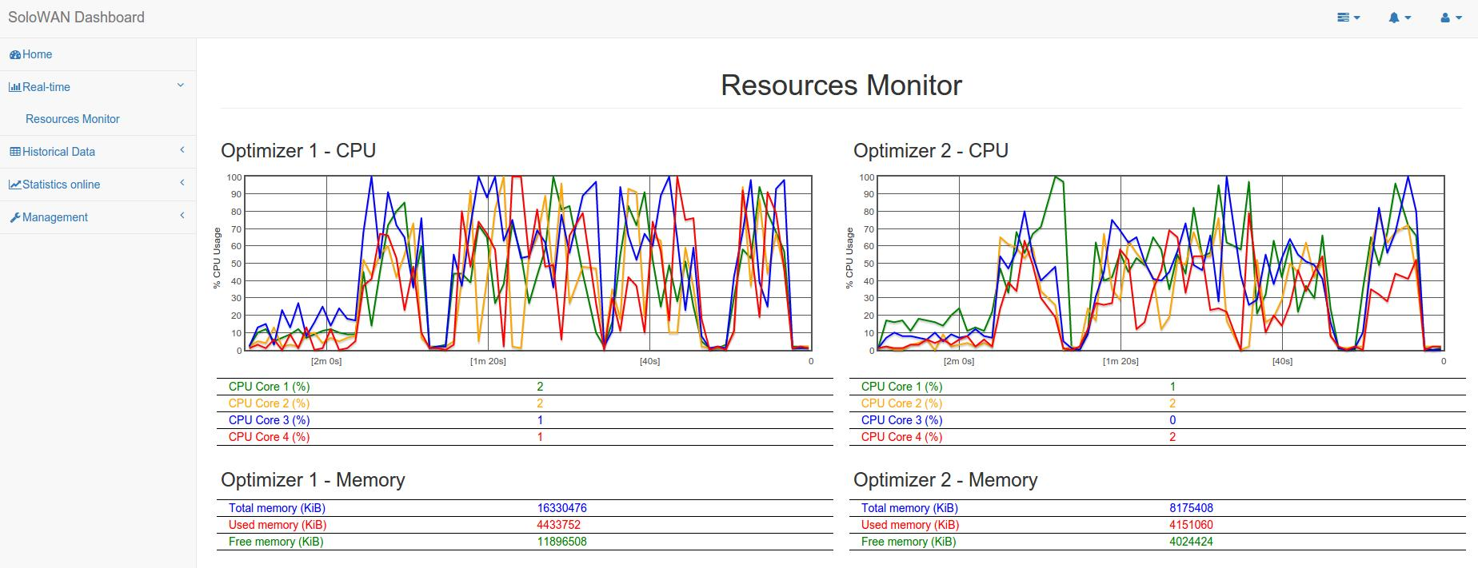
Web application interface
Limited management and real time statistics:

Slide 15
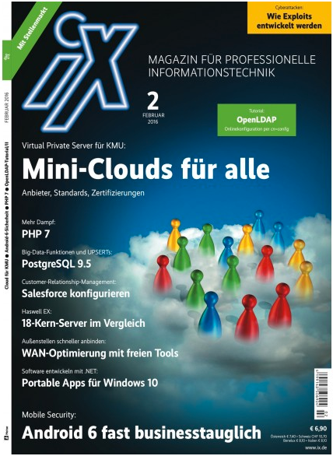
SoloWAN in German IT press
SoloWAN in the popular German enterprise IT magazine:
iX - Magazin für Professionelle Informationstechnik
Article about open source based WAN optimization solutions:
  OpenNOP
  SoloWAN
  TrafficSqueezer
  Wanproxy
Includes laboratory tests:
  Highlights the easy installation and high compression rate provided by SoloWAN

Slide 16
SoloWAN Scenarios
Traffic redirection based on WCCPv2
Optimizers
Optimizers
LAN 1
Router 1
Router 2
LAN 2
h1
h4
WCCP
WAN
WCCP
h2
WAN
h5
h3
h6
o1
o2
Notes:
Los optimizadores o1 y o2 envían un mensaje WCCP a los routers para indicar redirección del tráfico deseado (en este caso todos los paquetes cuyo puerto origen o destino sea el 80)
Los optimizadores procesan los paquetes y lo reenvían a su destino.
16

Slide 17

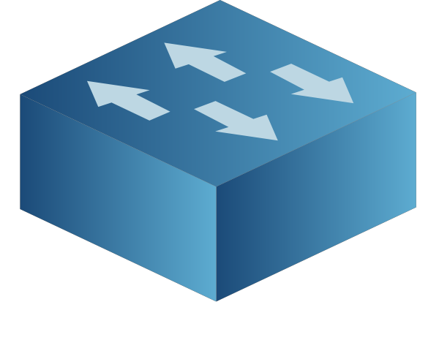
SoloWAN cloud architecture
Create a scalable architecture based in SoloWAN with support for multiple parallel optimizers
  Multiple threads per machine
  Multiple servers
Use cloud computing paradigms to add optimizers as needed
Easy
expansion(plug&play)
O4
D4
Optimizer
Traffic Load Balancer
(SDN based)
O3
D3
O2
D2
O1
D1
LAN
LAN

Slide 18
SDN based SoloWAN cloud architecture
Reference and testbed scenario:
WAN Optimizer
WAN Optimizer
LAN A
LAN B
Router 1
Router 2
h11
h21
WAN
h12
lb1
lb2
h22
h13
h23
o11
o12
o13
o21
o22
o23
Floodlight OpenFlow Controllers
Notes:
Configuración de los optimizadores:
thrnum 1
num_pkt_cache_size 262144
pkt_size 1500
fp_per_pkt 32
fps_factor 2
Ocupación en memoria de cada optimizador: 3 GBs (fórmula: 2 x thrnum x num_pkt_cache_size x (pkt_size + 64 x fp_per_pkt x fps_factor).
Limitación de CPU al 25% para cada optimizador.
Se comparará dos modos de optimización:
Solo deduplicación
Combinada: Deduplicación + Compresión.
Ficheros de pruebas: Silesia Corpus.
Se trata de un conjunto de ficheros que engloban los tipos de datos típicos usados hoy en día:
Tamaño: 211 MBs.
Transferencias:
h21 -> h11
h22 -> h12
h23 -> h13

Slide 19
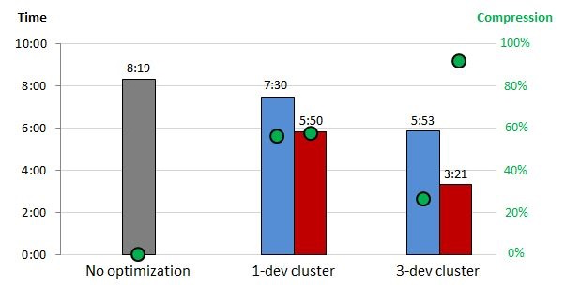
Scalable architecture Tests

Slide 20
WAN Optimization as a Service
Idea: Integrate WAN optimization as a service available in Openstack IaaS
Proof of Concept implementation developed
  https://github.com/carlosv5/OaaS-network
Based on Firewall as a Service (FWaaS) Openstack code

Slide 21
Typical Openstack Scenario
Management Network
eth1
eth1
eth1
eth1
controller
network
compute1
compute2
vm1
vm2
vm3
vm4
Router
vm5
Sw
Sw
NAT
eth2
eth3
eth2
eth2
eth2
Virtual Network
Tunnel Network
External Network
Internet

Slide 22
WAN Optimization as a Service
Management Network
eth1
eth1
eth1
eth1
controller
network
compute1
compute2
FWaaS
vm1
vm2
vm3
vm4
Router
LBaaS
vm5
Sw
Sw
NAT
WOaaS
eth2
eth3
eth2
eth2
eth2
Virtual Network
Tunnel Network
External Network
Internet

Slide 23
WOaaS Complete Test Scenario (I)
Basic scenario tested over two Openstack clouds
h1
O1
O2
h2
WAN
Cloud A
Cloud B
Management Network
Management Network
eth1
eth1
eth1
compute1
network
controller
eth1
eth1
eth1
controller
network
compute1
h1
WOaaS
Router
Router
WOaaS
h2
NAT
NAT
eth2
eth2
eth3
eth2
eth2
eth3
eth2
eth2
Virtual Network
Virtual Network
Tunnel Network
Tunnel Network
External Network A
External Network B
GRE tunnel

Slide 24
WOaaS Complete Test Scenario (II)
Testing infrastructure:
Cloud A
Cloud B
Management Network
Management Network
eth1
eth1
eth1
compute1
network
controller
eth1
eth1
eth1
controller
network
compute1
h1
WOaaS
Router
Router
WOaaS
h2
NAT
NAT
eth2
eth2
eth3
eth2
eth2
eth3
eth2
eth2
Virtual Network
Virtual Network
Tunnel Network
Tunnel Network
Virtual Scenario A
External Network A
External Network B
Virtual Scenario B
GRE tunnel
LaptopA
LaptopB
Switch

Slide 25
WAN Optimization as a Service
Management Network
eth1
eth1
eth1
eth1
controller
network
compute1
compute2
Router +
WAN optimizator
vm1
vm2
vm3
vm4
Sw
Sw
vm5
NAT
eth2
eth3
eth2
eth2
eth2
Virtual Network
Tunnel Network
External Network
Internet

Slide 26
Virtual Testbeds
Most SoloWAN testbeds developed using virtual testbeds based on VNX tool
Combining VM and virtual network emulation on the host it is possible to run Virtual Network Scenarios
Virtual Scenario
Host
Net 2
Virtual nodes
Net 1
Net 3
Net 4
Net1
Net2
Net3
Internet
Net4
Virtual
Networks
Real Scenario
VNX tool
http://www.dit.upm.es/vnx
Internet
Notes:
26

Slide 27

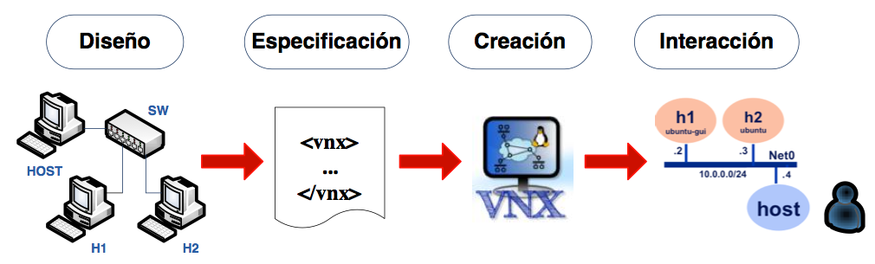
VNX: Virtual Networks over LinuX
VNX is a general purpose open-source virtualization tool designed to help building virtual network testbeds automatically
Characteristics:
  Uses libvirt (Linux virtualization library)
  Autoconfiguration for Linux, FreeBSD, OpenBSD and Windows
  Support for Dynamips (CISCO) and Olive (Juniper)
  LXC containers support
  Open vSwitch support
Design
Specification
Creation
Interaction
http://www.dit.upm.es/vnx

Slide 28
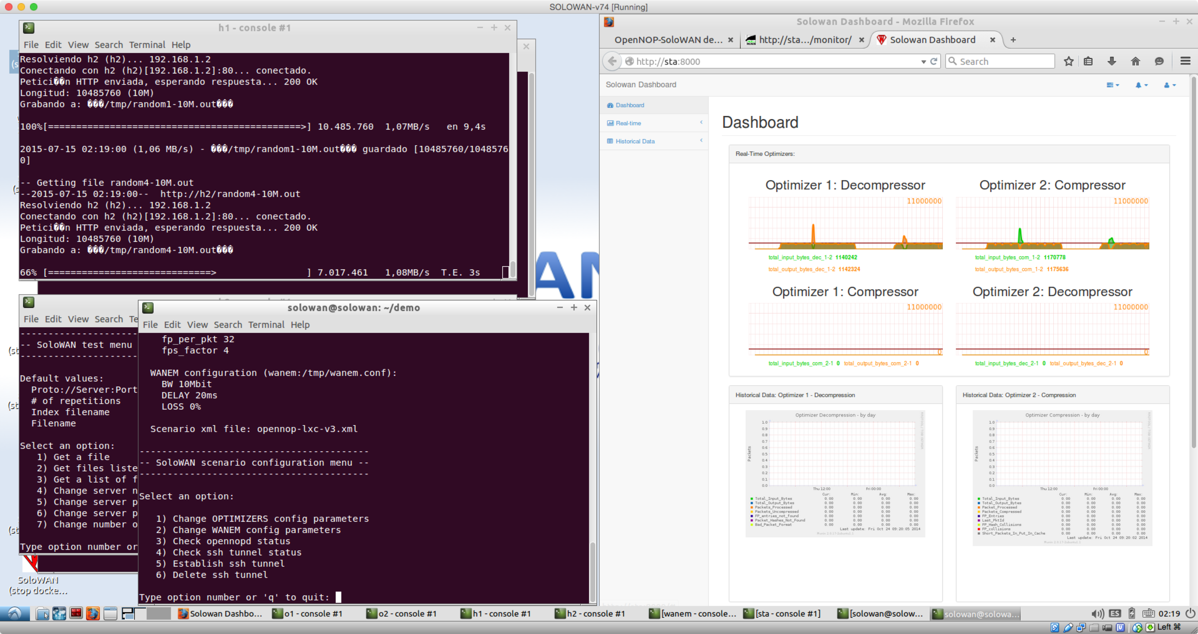
SoloWAN Demo VM
Ubuntu VM including SoloWAN virtual scenarios
Available at: https://goo.gl/YE6QXW

Slide 29
VNX Example scenario: Collaborative OSPF/BGP Practice
Requirements for ~400 students:
Backbone: 15 dynamips routers, 5 servidores
Cient networks : 400 x 5 routers Linux with quagga routers, 4 PCs
Switches
Configuration management
  400 different configurations

Slide 30
References
Center for Open Middleware (COM).
  http://www.centeropenmiddleware.com/
SoloWAN repository at Github.
  https://github.com/solowan/solowan
Virtual Networks over Linux (VNX).
  http://vnx.dit.upm.es
WOaaS Prof-of-concept implementation.
  https://github.com/carlosv5/OaaS-network

Slide 31
Thanks for your attention
Any questions?
Universidad Politécnica de Madrid (UPM)

